Slide 1

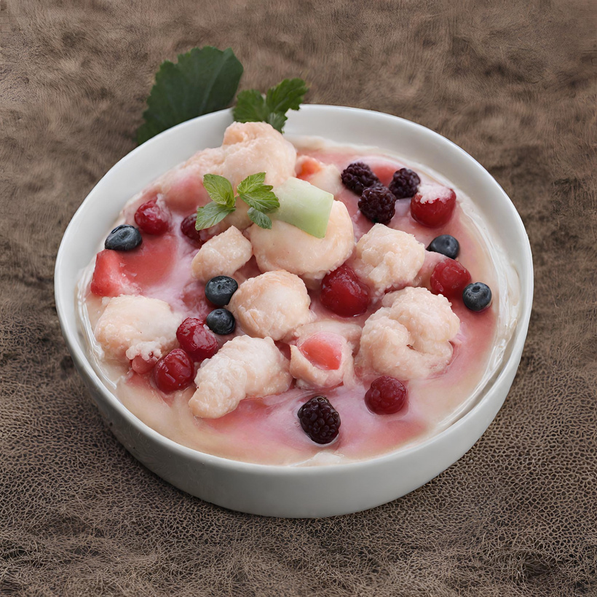

Restaurent
Reservation
Bot
PROPOSED BY
-TAMILARASU A
-422521104038
tamilarasu1881@gmail.com
University college of engineering-villupuram

Slide 2
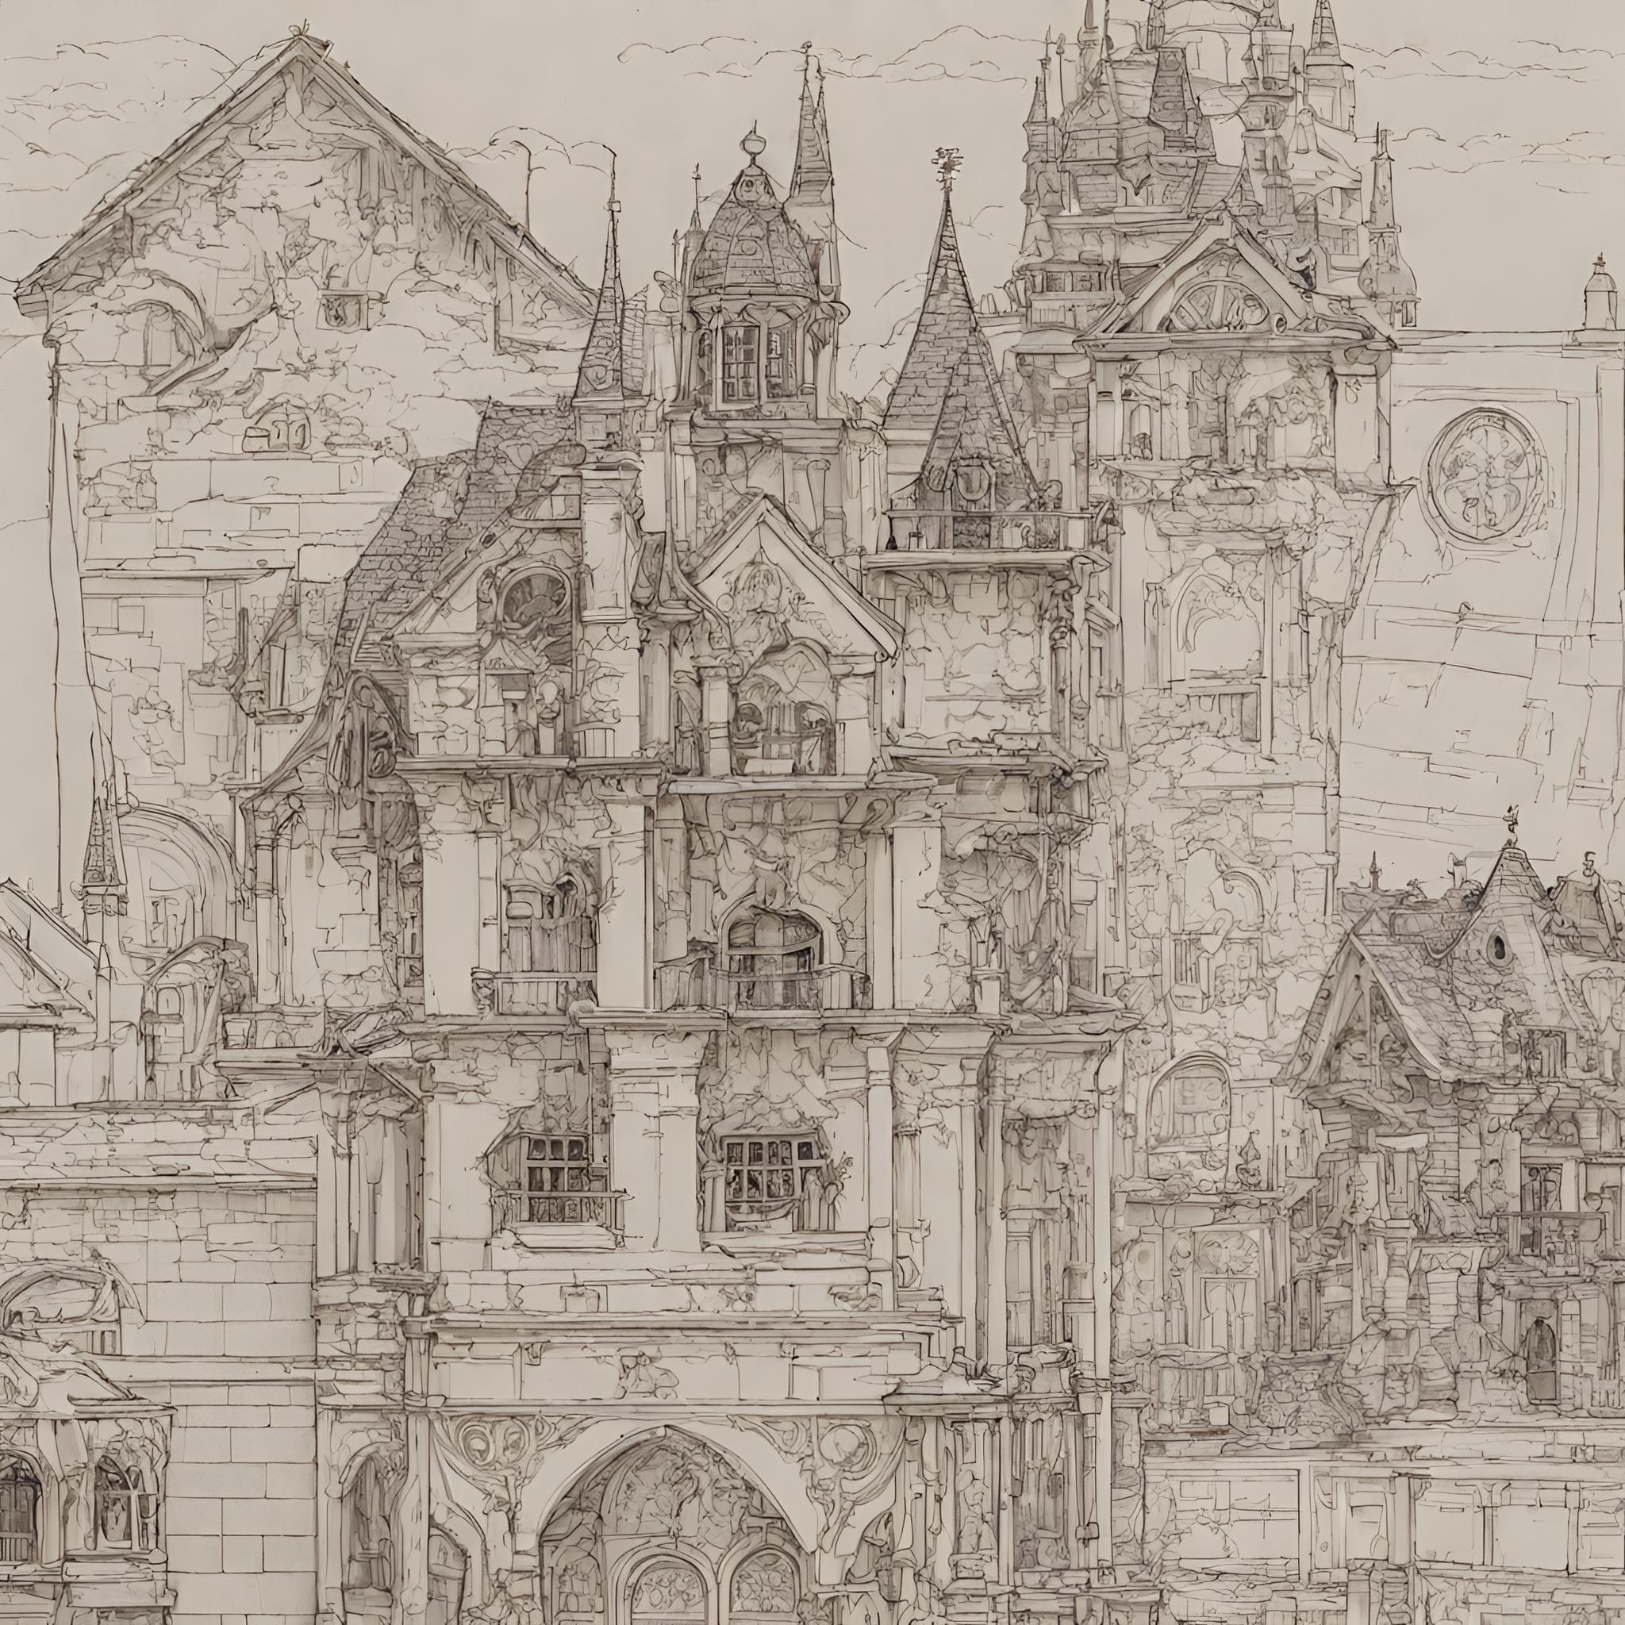



AGENDA
TITLE
--problem Statement
--proposed solution
--System Approach
--Algorithm
--Result
--Conclusion
--Reference

Slide 3

Problem statement
The project aims to develop a Restaurant Reservation Bot utilizing Long Short-Term Memory (LSTM) networks to automate the booking process. The bot will be designed to understand natural language inputs from users, such as reservation requests, party size, preferred date and time, and special requirements. Through LSTM's memory retention capabilities, the bot will maintain context throughout the conversation and generate coherent responses. Additionally, it will integrate with restaurant reservation systems to provide real-time availability updates and ensure secure handling of user data. The ultimate goal is to create a seamless and efficient reservation experience for both customers and restaurant staff.

Slide 4

Natural Language Understanding and Generation:
For natural language understanding, the bot will utilize LSTM networks trained on a dataset of user queries and responses. The LSTM model will be capable of parsing various types of user inputs, including reservation requests, party size, date and time preferences, and any special requirements.
Integration with Reservation Systems:
The bot will integrate with restaurant reservation systems through APIs (Application Programming Interfaces) provided by these systems. These APIs will allow the bot to access real-time availability information, make reservations, and retrieve booking confirmations.
Proposed
Solution

Slide 5



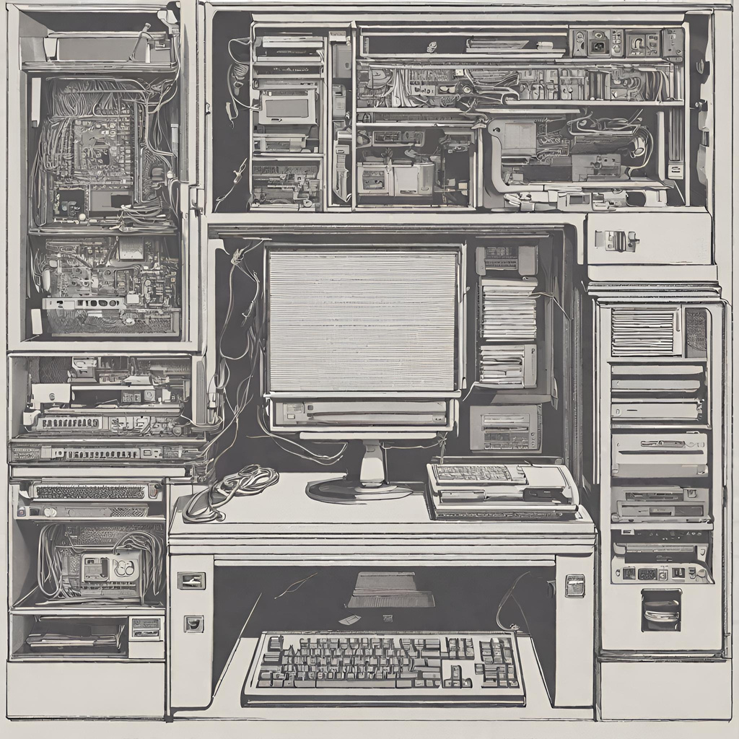

System
Approach
Hardware:
->CPU: A multi-core CPU is adequate for processing user requests and running the LSTM model efficiently.
->Memory (RAM): A minimum of 8GB of RAM is recommended for handling user interactions and maintaining context. Additional RAM may be beneficial for larger conversational datasets and more complex models.
-->Internet Connection: An internet connection is necessary for accessing external APIs, retrieving real-time reservation information, and providing updates to users.

Slide 6


Software
Python: The project is implemented using the Python programming language for its versatility and extensive libraries.
TensorFlow/Keras: TensorFlow, along with its high-level API Keras, is utilized for building, training, and deploying LSTM models due to its robustness and ease of use in deep learning tasks.
Natural Language Processing (NLP) Libraries: Libraries such as NLTK (Natural Language Toolkit) or spaCy are used for processing and understanding user input in natural language.
Flask/Django: Web frameworks like Flask or Django are employed for creating the bot's backend infrastructure, providing HTTP endpoints for communication and handling reservation requests.

Slide 7




ALGORITHM & DEPLOYMENT
Your first inspirational sentence for the presentation
1.LSTM Model Development:
• Developed the core functionality of [Your Restaurant's Name] Bot using
a Long Short-Term Memory (LSTM) deep learning model.
• LSTM enables the bot to understand and generate responses based on
the context of user queries, enhancing the conversational experience.
2.Training the LSTM Model:
•Trained the LSTM model on a dataset comprising past booking
interactions and customer preferences.
•Utilized techniques such as sequence modelling
and backpropagation to \optimize the model for accurate predictions.
3.Hyperparameter Tuning:
• Conducted extensive experiments to fine-tune hyperparameters such
as learning rates, sequence lengths, and network architectures.
• Selected the optimal hyperparameters to improve the performance
and efficiency of the LSTM model.

Slide 8



ALGORITHM & DEPLOYMENT
Topic Title
4.Deployment:
• The trained GAN model and associated code are deployed into a GitHub repository.
• Included instructions for setting up the environment and running
the code.
• Created documentation and README files explproject, algoriand deployment instructions.
5.Performance Evaluation:
• User Interaction Analysis:* Evaluate the chatbot's performance by analyzing interactions between users and the bot.
• Sentiment Analysis:* Use sentiment analysis to gauge user satisfaction based on the sentiment expressed. .
• Error Analysis:* Conduct an error analysis to ident mistakes made by the chatbot and areas for improvement.
4.Deployment:
• The trained GAN model and associated code are deployed into a GitHub repository.
• Included instructions for setting up the environment and running the code.
• Created documentation and README files explproject, algoriand deployment instructions.
5.Performance Evaluation:
• User Interaction Analysis:* Evaluate the chatbot's performance by analysing interactions between users and the bot.
• Sentiment Analysis:* Use sentiment analysis to gauge user satisfaction based on the sentiment expressed. .
• Error Analysis:* Conduct an error analysis to ident mistakes made by the chatbot and areas for improvement.
Your first inspirational sentence for the presentation
1
2
3
Subtitle
Subtitle
Subtitle
Detail
Detail
Detail

Slide 9

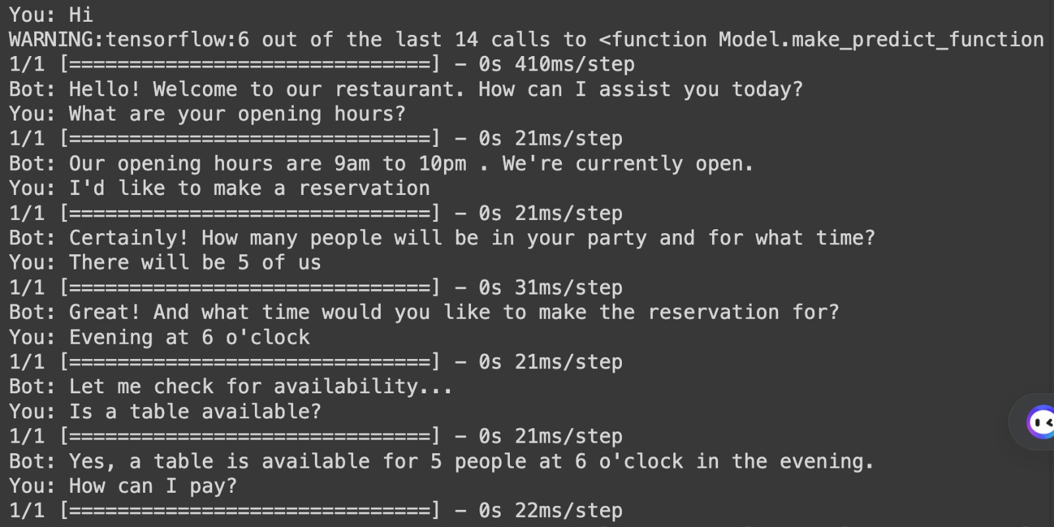
Result

Slide 10
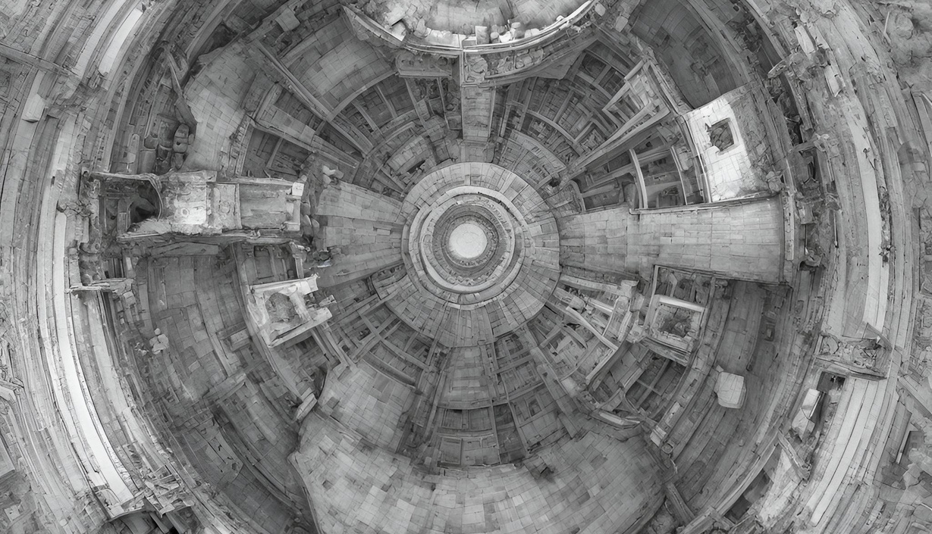
In conclusion, our restaurant chatbot, powered by LSTM deep learning technology, represents a significant advancement in customer service and operational efficiency within the dining industry. Through its ability to understand user queries, provide personalized recommendations, and seamlessly handle reservations, the chatbot streamlines the booking process and enhances the overall dining experience for customers.
Conclusion:

Slide 11
Reference:
https://docs.python.org/3/library/json.html
https://numpy.org/
https://www.tensorflow.org/
https://keras.io/
https://www.tensorflow.org/api_docs/python/tf/keras/preprocessing/text/Tokenizer
https://www.tensorflow.org/api_docs/python/tf/keras/utils/pad_sequences
LINKS
Research Papers:
Official Documentation
Look for academic papers or research articles related to natural language processing (NLP) using LSTM networks, integration with reservation systems, and conversational agents. These papers often provide detailed explanations of the methodologies and technologies used, along with references to relevant tools and frameworks.
Official Documentation: Explore the official documentation and guides for software frameworks and tools mentioned, such as TensorFlow, PyTorch, MySQL, PostgreSQL, Apache, Nginx, and encryption libraries. These resources typically offer information on system requirements, installation instructions, usage guidelines, and best practices.

Slide 12
Thank you!

